Slide 1
Welcome to my presentation on HTML, CSS, Bootstrap
Presented to:
Grid Solutions
Presented By
Md. Ashik Mahmud

Slide 2
Introduction to HTML
What is HTML
HTML is the standard markup language for creating Web pages
HTML stands for Hyper Text Markup Language
HTML describes the structure of a Web page
Using HTML, you can create a Web page with text, graphics, sound, and video

Slide 3
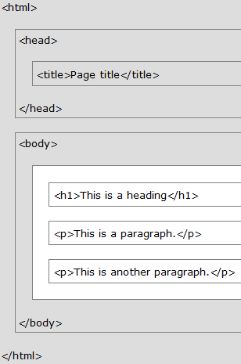
HTML Page Structure
All Web pages share a common structure
All Web pages should contain a pair of <HTML>, <HEAD>, <TITLE>, and <BODY> tags

Slide 4
Text Formatting Tags
<b> element defines bold text, without any extra importance.
<strong> element defines strong text, with added semantic "strong" importance.
<i> element defines italic text, without any extra importance.
<em> element defines emphasized text, with added semantic importance.
<small> element defines smaller text
<mark> element defines marked or highlighted text
<del> element defines deleted (removed) text
<ins> element defines inserted (added) text
<sub> element defines _{subscripted} text.
<sup> element defines ^{superscripted} text
<br> Next Line

Slide 5
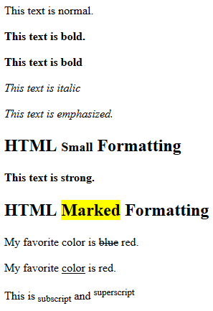
HTML Text Formatting Example
<!DOCTYPE html>
<html>
<body>
<p>This text is normal.</p>
<p><b>This text is bold.</b></p>
<p><b>This text is bold</b></p>
<p><i>This text is italic</i></p>
<p><em>This text is emphasized.</em></p>
<h2>HTML <small>Small</small> Formatting</h2>
<p><strong>This text is strong.</strong></p>
<h2>HTML <mark>Marked</mark> Formatting</h2>
<p>My favorite color is <del>blue</del> red.</p>
<p>My favorite <ins>color</ins> is red.</p>
<p>This is<sub> subscript</sub> and <sup>superscript</sup></p>
</body>
</html>

Slide 6
HTML Quotation and Citation
Tag Description
<abbr> Defines an abbreviation.
<address> Defines contact information for the author/owner of a document. <address> element is usually displayed in italic.
<bdo> Defines the text direction. The <bdo> element is used to reverse the current text direction:
<blockquote> Defines a section that is quoted from another source
<cite> Defines the title of a work. Browsers usually display <cite> elements in italic.
<q> Defines a short inline quotation. Browsers normally insert quotation marks around the quotation.

Slide 7
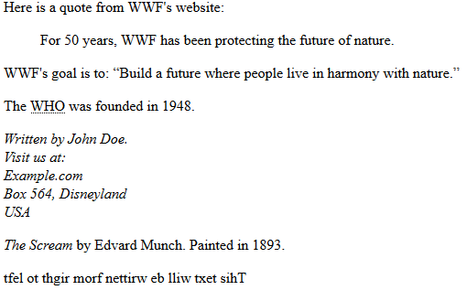
Example
<p>Here is a quote from WWF's website:</p>
<blockquote cite="http://www.worldwildlife.org/who/index.html">
For 50 years, WWF has been protecting the future of nature.
</blockquote>
<p>WWF's goal is to: <q>Build a future where people live in harmony with nature.</q></p>
<p>The <abbr title="World Health Organization">WHO</abbr> was founded in 1948.</p>
<address>
Written by John Doe.<br>
Visit us at:<br>
Example.com<br>
Box 564, Disneyland<br>
USA
</address>
<p><cite>The Scream</cite> by Edvard Munch. Painted in 1893.</p>
<bdo dir="rtl">This text will be written from right to left</bdo>

Slide 8
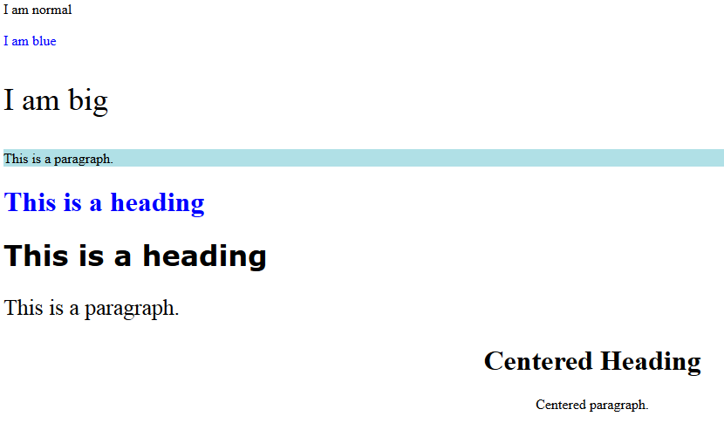
HTML Styles
<!DOCTYPE html>
<html>
<body>
<p>I am normal</p>
<p style="color:blue;">I am blue</p>
<p style="font-size:36px;">I am big</p>
<p style="background-color:powderblue;">This is a paragraph.</p>
<h1 style="color:blue;">This is a heading</h1>
<h1 style="font-family:verdana;">This is a heading</h1>
<p style="font-size:160%;">This is a paragraph.</p>
<h1 style="text-align:center;">Centered Heading</h1>
<p style="text-align:center;">Centered paragraph.</p>
</body>
</html>

Slide 9
Heading Tags
Heading tags define the sections on your page.
Headings are hierarchical: Heading 1, Heading 2, Heading 3, etc.
The format of Heading tags is
<h1>This Is Heading 1</h1>
<h2>This Is Heading 2</h2>
<h3>This Is Heading 3</h3>

Slide 10
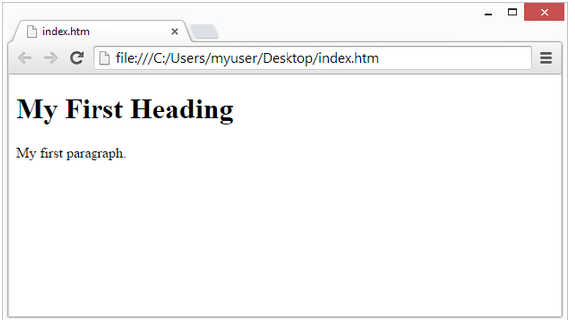
Write Some HTML
<!DOCTYPE html> <html> <body> <h1>My First Heading</h1> <p>My first paragraph.</p> </body> </html>

Slide 11
HTML Paragraphs, Links
<!DOCTYPE html>
<html>
<body>
<p>If you want to go for job searching press the link is given below <br>
<a href="http://bdjobs.com/">This is a link</a>
</p>
</body>
</html>
HTML paragraphs are defined with the <p> tag
HTML links are defined with the <a> tag
Most browsers will display HTML correctly even if you forget the end tag

Slide 12

HTML Images
<!DOCTYPE html>
<html>
<body>
<img src="job.jpg" alt="image unload" width="104" height="142">
</body>
</html>
HTML images are defined with the <img> tag.
The source file (src), alternative text (alt), width, and height are provided as attributes:

Slide 13
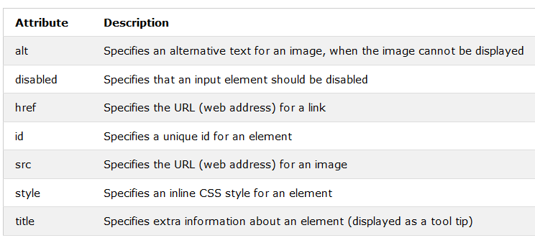
HTML Attributes List

Slide 14
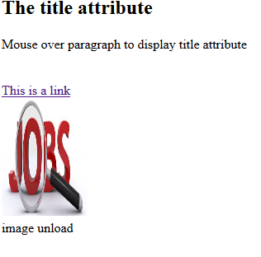
HTML Attributes Example
<body>
<h2>The title attribute</h2>
<p title="I'm a tooltip">
Mouse over paragraph to display title attribute
</p> <br>
<a href="https://www.bdjobs.com">This is a link</a> <br>
<img src="job.jpg" width="104" height="142"> <br>
<img src="jobs.jpg" alt="image unload" width="104" height="142">

Slide 15
Hyperlinks
HTML files can contain hyperlinks to files on the same computer or around the world.
3 types of links:
external,
internal and
mail to

Slide 16
External Links
All Link tags require two components
The location you want to link to
The text that you want to appear on the page
<a href=“http://www.ucsb.edu”>Link Text</a>
In an external link, this is the web address of the site

Slide 17
Internal Links
An internal link is very similar to an external one.
The difference is that you are linking to another html file on your own server.
You’ll first need to decide what to name the second file - remember all lowercase, no spaces.
Then construct a link with the name of your new file: <a href=“page2.html”>Next</a>

Slide 18
Mail-to Links
These allow interested viewers to contact you.
<a href=“mailto:kknight08@gmail.com”> Contact Me</a>

Slide 19
HTML Comments
You can add comments to your HTML source by using the following syntax:
<!-- Write your comments here -->
Notice that there is an exclamation point (!) in the opening
tag, but not in the closing tag.
Comments are also great for debugging HTML, because you can comment out HTML lines of code, one at a time, to search for errors

Slide 20
HTML Tables
HTML table is defined with the <table> tag.
Each table row is defined with the <tr> tag.
A table header is defined with the <th> tag. By default, table headings are bold and centered.
A table data/cell is defined with the <td> tag..
<table style="width:100%">
<tr>
<th>Firstname</th>
<th>Lastname</th>
<th>Age</th>
</tr>
<tr>
<td>Jill</td>
<td>Smith</td>
<td>50</td>
</tr>
</table>

Slide 21
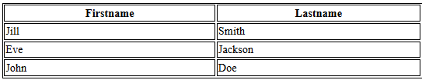
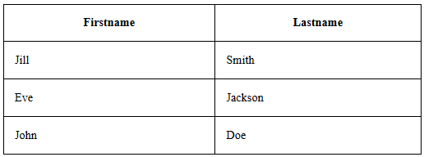
HTML Tables
Adding a Border
If you do not specify a border for the table, it will be displayed without borders. A border is set using the CSS border property:
Example
table, th, td { border: 1px solid black; }
Collapsed Borders
If you want the borders to collapse into one border, add the CSS border-collapse property
Example
table, th, td { border: 1px solid black; border-collapse: collapse; }

Slide 22
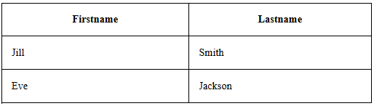
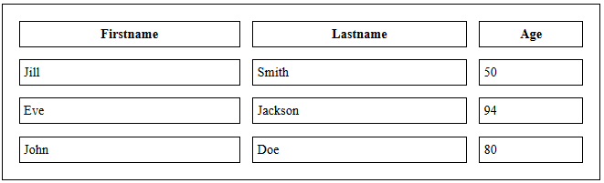
HTML Tables
Adding Cell Padding
Cell padding specifies the space between the cell content and its borders.
the table cells will be displayed without padding.
To set the padding, use the CSS padding property:
Example
th, td { padding: 15px; }
Adding Border Spacing
Border spacing specifies the space between the cells.
To set the border spacing for a table, use the CSS border-spacing property:
Example
table { border-spacing: 5px; }

Slide 23
HTML Tables
Cells that Span Many Columns
To make a cell span more than one column, use the colspan attribute
<table style="width:100%">
<tr>
<th>Name</th>
<th colspan="2">Telephone</th>
</tr>
<tr>
<td>Bill Gates</td>
<td>55577854</td>
<td>55577855</td>
</tr>
</table>

Slide 24
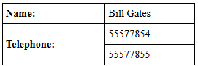
HTML Tables
Cells that Span Many Rows
To make a cell span more than one row, use the rowspan attribute
<table style="width:100%">
<tr>
<th>Name:</th>
<td>Bill Gates</td>
</tr>
<tr>
<th rowspan="2">Telephone:</th>
<td>55577854</td>
</tr>
<tr>
<td>55577855</td>
</tr>
</table>

Slide 25
HTML Unordered Lists
An unordered list starts with the <ul> tag. Each list item starts with the <li> tag.
The list items will be marked with bullets (small black circles) by default
Unordered HTML List - Choose List Item Marker
The CSS list-style-type property is used to define the style of the list item marker
Value | Description
disc | Sets the list item marker to a bullet (default)
circle | Sets the list item marker to a circle
square | Sets the list item marker to a square
none | The list items will not be marked

Slide 26
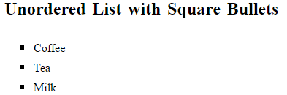
Unordered HTML List
<!DOCTYPE html>
<html>
<body>
<h2>Unordered List with Square Bullets</h2>
<ul style="list-style-type: square">
<li>Coffee</li>
<li>Tea</li>
<li>Milk</li>
</ul>
</body>
</html>

Slide 27
HTML Ordered Lists
An ordered list starts with the <ol> tag. Each list item starts with the <li> tag.
The list items will be marked with numbers by default
Ordered HTML List - The Type Attribute
The type attribute of the <ol> tag, defines the type of the list item marker
Type | Description
type="1" | The list items will be numbered with numbers (default)
type="A" | The list items will be numbered with uppercase letters
type="a" | The list items will be numbered with lowercase letters
type="I" | The list items will be numbered with uppercase roman numbers
type="i" | The list items will be numbered with lowercase roman numbers

Slide 28
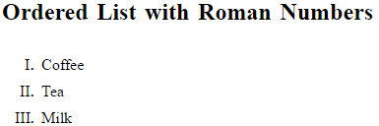
Ordered HTML List
<!DOCTYPE html>
<html>
<body>
<h2>Ordered List with Roman Numbers</h2>
<ol type="I">
<li>Coffee</li>
<li>Tea</li>
<li>Milk</li>
</ol>
</body>
</html>

Slide 29
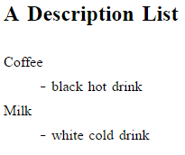
HTML Description Lists
HTML also supports description lists.
A description list is a list of terms, with a description of each term.
The <dl> tag defines the description list, the <dt> tag defines the term (name), and the <dd> tag describes each term
<h2>A Description List</h2>
<dl>
<dt>Coffee</dt>
<dd>- black hot drink</dd>
<dt>Milk</dt>
<dd>- white cold drink</dd>
</dl>

Slide 30
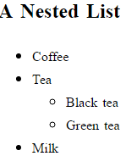
Nested HTML Lists Example
<h2>A Nested List</h2>
<ul>
<li>Coffee</li>
<li>Tea
<ul>
<li>Black tea</li>
<li>Green tea</li>
</ul>
</li>
<li>Milk</li>
</ul>

Slide 31
HTML Block and Inline Elements
Block-level Elements
A block-level element always starts on a new line and takes up the full width available (stretches out to the left and right as far as it can).
The <div> element is a block-level element.
Examples of block-level elements:
<div>
<h1> - <h6>
<p>
<form>
Inline Elements
An inline element does not start on a new line and only takes up as much width as necessary.
This is an inline <span> element inside a paragraph.
Examples of inline elements:
<span>
<a>
<img>

Slide 32
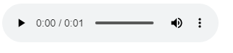
Audio Elements on Web in HTML
To play an audio file in HTML, use the <audio> element
The controls attribute adds audio controls, like play, pause, and volume.
The <source> element allows you to specify alternative audio files which the browser may choose from. The browser will use the first recognized format.
<audio controls="audiocontrols">
<source src="music.mp3"/>
<source src="music.wav"/>
</audio>
<!-- Three standard formats for web browsers are .mp3 .wav -->

Slide 33
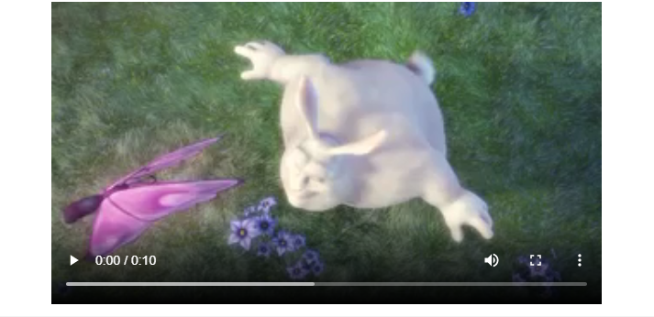
Video Elements on Web in HTML
To show a video in HTML, use the <video> element
The controls attribute adds video controls, like play, pause, and volume.
It is a good idea to always include width and height attributes.
The <source> element allows you to specify alternative video files which the browser may choose from. The browser will use the first recognized format.
<video width="640" height="360" controls>
<source src="scientist.mp4"/>
<source src="scientist.wmv"/>
</video>
<!-- Standard video formats for web browsers are .mp4, wmv -->

Slide 34
HTML Marquees
An HTML marquee is a scrolling piece of text displayed either horizontally across or vertically down your webpage depending on the settings. This is created by using HTML <marquees> tag.
<title>HTML marquee Tag</title>
</head>
<body>
<marquee>This is basic example of marquee</marquee>
</body>
</html>

Slide 35
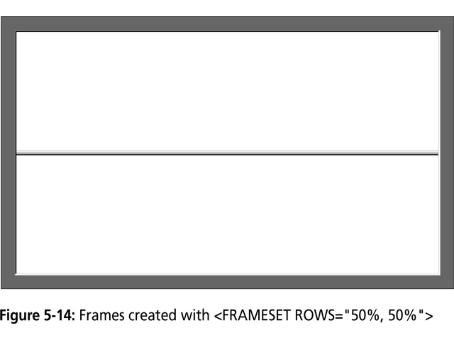
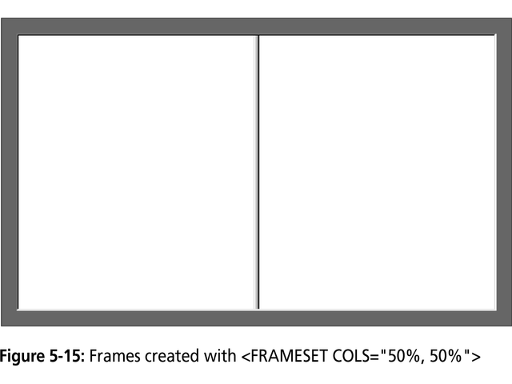
HTML Frames
HTML frames are used to divide browser window into multiple sections
A collection of frames in the browser window is known as a frameset.
The <frameset> tag defines how to divide the window into frames. The rows attribute of <frameset> tag defines horizontal frames and cols attribute defines vertical frames.
Each frame is indicated by <frame> tag

Slide 36
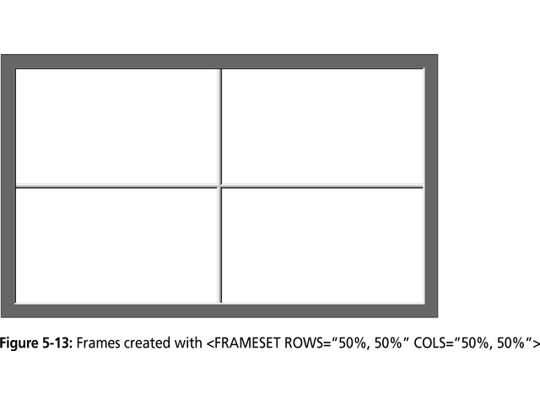
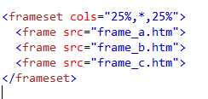
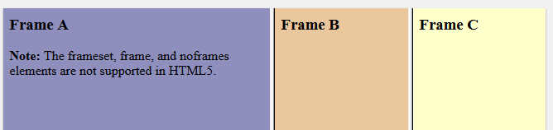
HTML Frames

Slide 37
HTML Iframes
An iframe is used to display a web page within a web page.
The <iframe> tag defines a rectangular region within the document in which the browser can display a separate document, including scrollbars and borders.
An HTML iframe is defined with the <iframe> tag:
<iframe src="URL"></iframe>
The src attribute specifies the URL (web address) of the inline frame page.
Iframe - Set Height and Width
Use the height and width attributes to specify the size of the iframe.
Example
15.IFrame Example

Slide 38
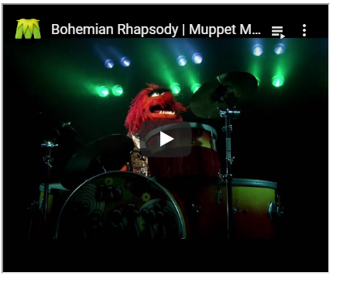
HTML YouTube Videos
<!DOCTYPE html>
<html>
<body>
<iframe width="420" height="345" src="https://www.youtube.com/embed/tgbNymZ7vqY?playlist=tgbNymZ7vqY&loop=1">
</iframe>
</body>
</html>

Slide 39
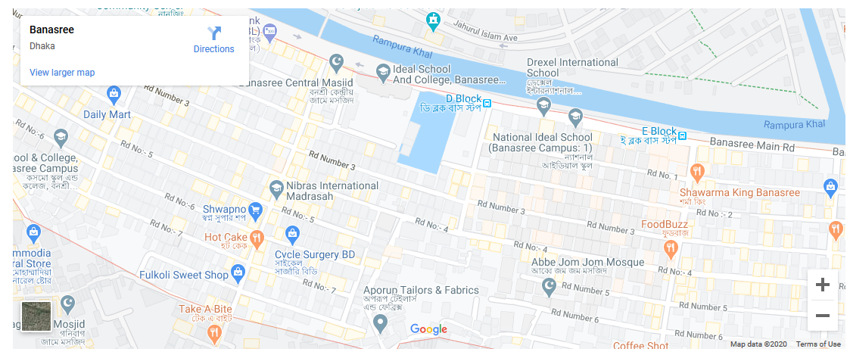
HTML Map Location
<iframe src="https://www.google.com/maps/embed?pb=!1m18!1m12!1m3!1d1535.3150157017312!2d90.44063877416157!3d23.761101933901617!2m3!1f0!2f0!3f0!3m2!1i1024!2i768!4f13.1!3m3!1m2!1s0x3755b80a03c8e22f%3A0xd52685f4a2fe003c!2sBanasree%2C%20Dhaka!5e0!3m2!1sen!2sbd!4v1581606299536!5m2!1sen!2sbd" width="1100" height="450" frameborder="0" style="border:0;" allowfullscreen=""></iframe>

Slide 40
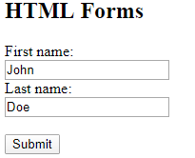
HTML Forms
<h2>HTML Forms</h2>
<form action="/action_page.php">
<label for="fname">First name:</label><br>
<input type="text" id="fname" name="fname" value="John"><br>
<label for="lname">Last name:</label><br>
<input type="text" id="lname" name="lname" value="Doe"><br><br>
<input type="submit" value="Submit">
</form>

Slide 41
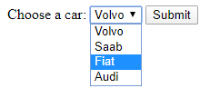
The select Element
<h2>The select Element</h2>
<p>The select element defines a drop-down list:</p>
<form action="/action_page.php">
<label for="cars">Choose a car:</label>
<select id="cars" name="cars">
<option value="volvo">Volvo</option>
<option value="saab">Saab</option>
<option value="fiat">Fiat</option>
<option value="audi">Audi</option>
</select>
<input type="submit">
</form>

Slide 42
HTML Input Types
<input type="button">
<input type="checkbox">
<input type="color">
<input type="date">
<input type="email">
<input type="file">
<input type="hidden">
<input type="image">
<input type="month">
<input type="number">
<input type="password">
<input type="radio">
<input type="reset">
<input type="search">
<input type="submit">
<input type="text">
<input type="time">
<input type="url">

Slide 43
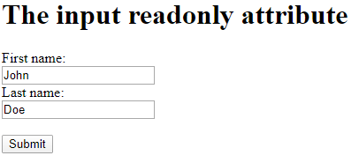
The readonly Attribute
<h1>The input readonly attribute</h1>
<form action="/action_page.php">
<label for="fname">First name:</label><br>
<input type="text" id="fname" name="fname" value="John" readonly><br>
<label for="lname">Last name:</label><br>
<input type="text" id="lname" name="lname" value="Doe"><br><br>
<input type="submit" value="Submit">
</form>

Slide 44
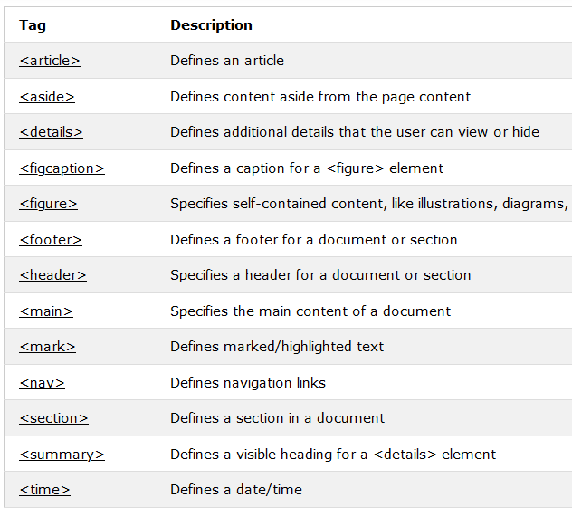
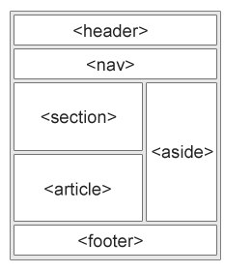
Semantic Elements in HTML

Slide 45
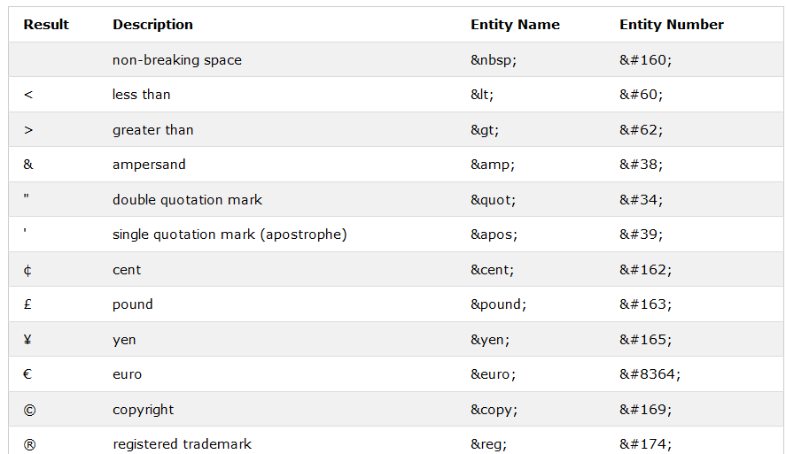
HTML Entities

Slide 46
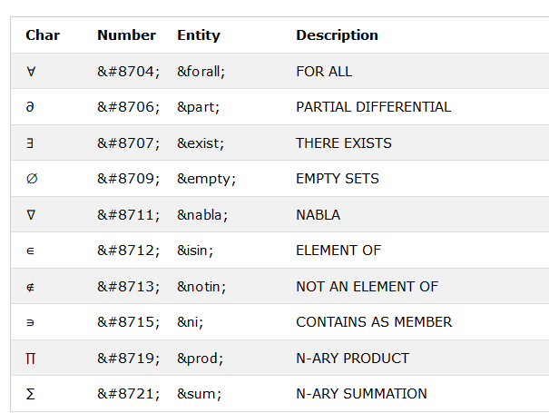
HTML Mathematical Symbols

Slide 47
CSS
CSS stands for Cascading Style Sheets.
CSS describes how HTML elements are to be displayed on screen, paper, or in other media.
CSS saves a lot of work. It can control the layout of multiple web pages all at once.
CSS can be added to HTML elements in 3 ways:
Inline - by using the style attribute in HTML elements
Internal - by using a <style> element in the <head> section
External - by using an external CSS file
The most common way to add CSS, is to keep the styles in separate CSS files. However, here we will use inline and internal styling, because this is easier to demonstrate, and easier for you to try it yourself.

Slide 48
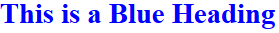
Inline CSS
<!DOCTYPE html>
<html>
<body>
<h1 style="color:blue;">This is a Blue Heading</h1>
</body>
</html>

Slide 49
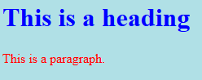
Internal CSS
An internal CSS is used to define a style for a single HTML page.
An internal CSS is defined in the <head> section of an HTML page, within a <style>
<!DOCTYPE html>
<html>
<head>
<style>
body {background-color: powderblue;}
h1 {color: blue;}
p {color: red;}
</style>
</head>
<body>
<h1>This is a heading</h1>
<p>This is a paragraph.</p>
</body>
</html>

Slide 50
External CSS
An external style sheet is used to define style for many HTML pages.
With an external style sheet, you can change the look of an entire web site, by changing one file.
To use an external style sheet, add a link to it in the <head> section of the HTML page:
external css .html
<!DOCTYPE html> <html> <head> <link rel="stylesheet" href="styles.css"> </head> <body> <h1>This is a heading</h1> <p>This is a paragraph.</p> </body> </html>
styles.css
body { background-color: powderblue; } h1 { color: blue; } p { color: red; }

Slide 51

CSS Syntax
The selector points to the HTML element you want to style.
The declaration block contains one or more declarations separated by semicolons.
Each declaration includes a CSS property name and a value, separated by a colon.

Slide 52
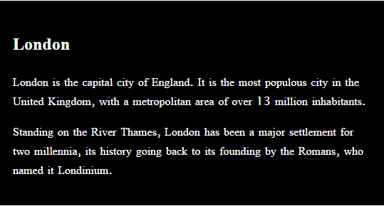
The <div> Element
The <div> element is often used as a container for other HTML elements.
The <div> element has no required attributes, but both style and class are common.
When used together with CSS, the <div> element can be used to style blocks of content
Example
<div style="background-color:black;color:white;padding:20px;">
<h2>London</h2>
<p>London is the capital city of England. It is the most populous city in the United.</p>
<p>Standing on the River Thames, London has been a major settlement </p>
</div>

Slide 53
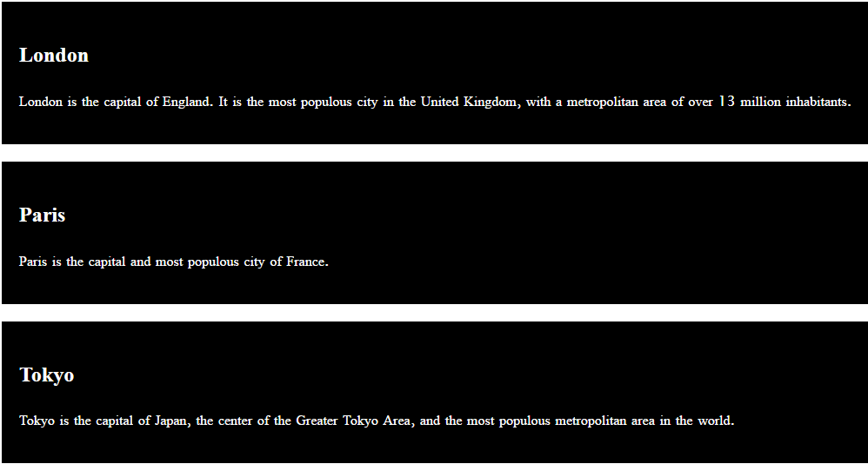
HTML The class Attribute
The HTML class attribute makes it possible to define equal styles for elements with the same class name.
<style> div.cities { background-color: black; color: white; margin: 20px 0 20px 0; padding: 20px; } </style> </head> <body> <div class="cities"> <h2>London</h2>
<p>London is the capital of England. It is the most populous city in the United Kingdom, with a metropolitan area of over 13 million inhabitants.</p> </div>

Slide 54
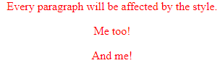
The CSS element Selector
<style>
p {
text-align: center;
color: red;
}
</style>
</head>
<body>
<p>Every paragraph will be affected by the style.</p>
<p id="para1">Me too!</p>
<p>And me!</p>

Slide 55
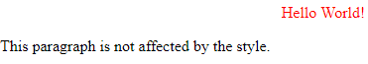
The CSS id Selector
<head>
<style>
#para1 {
text-align: center;
color: red;
}
</style>
</head>
<body>
<p id="para1">Hello World!</p>
<p>This paragraph is not affected by the style.</p>

Slide 56
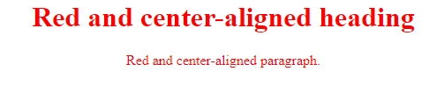
The CSS class Selector
<head>
<style>
.center {
text-align: center;
color: red;
}
</style>
</head>
<body>
<h1 class="center">Red and center-aligned heading</h1>
<p class="center">Red and center-aligned paragraph.</p>

Slide 57
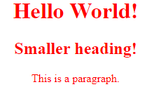
The CSS Grouping Selector
<head>
<style>
h1, h2, p {
text-align: center;
color: red;
}
</style>
</head>
<body>
<h1>Hello World!</h1>
<h2>Smaller heading!</h2>
<p>This is a paragraph.</p>

Slide 58
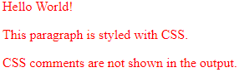
CSS Comments
<head>
<style>
/* This is
a multi-line
comment */
p {
color: red;
}
</style>
</head>
<body>
<p>Hello World!</p>
<p>This paragraph is styled with CSS.</p>
<p>CSS comments are not shown in the output.</p>

Slide 59
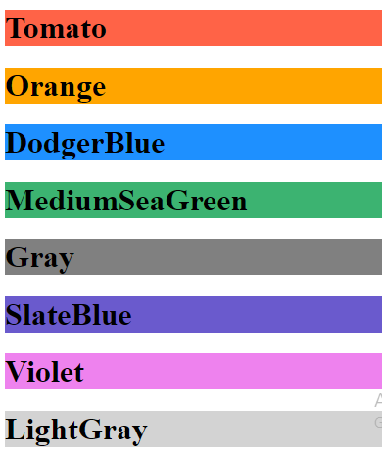
CSS Color
Colors are specified using predefined color names, or RGB, HEX, HSL, RGBA, HSLA values
<h1 style="background-color:Tomato;">Tomato</h1>
<h1 style="background-color:Orange;">Orange</h1>
<h1 style="background-color:DodgerBlue;">DodgerBlue</h1>
<h1 style="background-color:MediumSeaGreen;">MediumSeaGreen</h1>
<h1 style="background-color:Gray;">Gray</h1>
<h1 style="background-color:SlateBlue;">SlateBlue</h1>
<h1 style="background-color:Violet;">Violet</h1>
<h1 style="background-color:LightGray;">LightGray</h1>

Slide 60
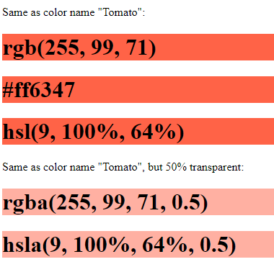
CSS Color
<p>Same as color name "Tomato":</p>
<h1 style="background-color:rgb(255, 99, 71);">rgb(255, 99, 71)</h1>
<h1 style="background-color:#ff6347;">#ff6347</h1>
<h1 style="background-color:hsl(9, 100%, 64%);">hsl(9, 100%, 64%)</h1>
<p>Same as color name "Tomato", but 50% transparent:</p>
<h1 style="background-color:rgba(255, 99, 71, 0.5);">rgba(255, 99, 71, 0.5)</h1>
<h1 style="background-color:hsla(9, 100%, 64%, 0.5);">hsla(9, 100%, 64%, 0.5)</h1>

Slide 61
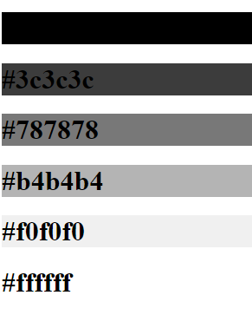
CSS Color
<h1 style="background-color:#000000;">#000000</h1>
<h1 style="background-color:#3c3c3c;">#3c3c3c</h1>
<h1 style="background-color:#787878;">#787878</h1>
<h1 style="background-color:#b4b4b4;">#b4b4b4</h1>
<h1 style="background-color:#f0f0f0;">#f0f0f0</h1>
<h1 style="background-color:#ffffff;">#ffffff</h1>
<p>By using equal values for red, green, and blue, you will get different shades of gray.</p>

Slide 62
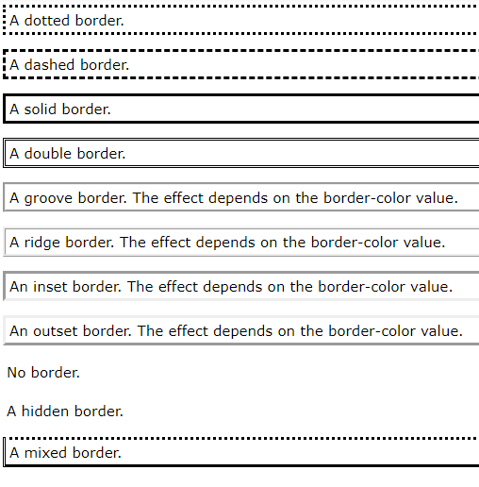
CSS Border Style
p.dotted {border-style: dotted;}
p.dashed {border-style: dashed;}
p.solid {border-style: solid;}
p.double {border-style: double;}
p.groove {border-style: groove;}
p.ridge {border-style: ridge;}
p.inset {border-style: inset;}
p.outset {border-style: outset;}
p.none {border-style: none;}

Slide 63
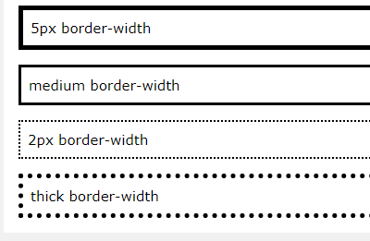
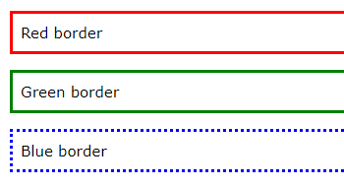
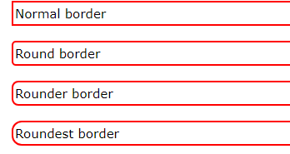
CSS Borders

Slide 64
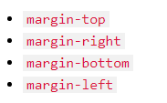
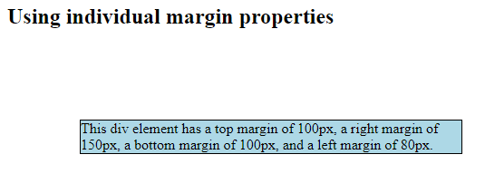
CSS Margins
<head>
<style>
div {
border: 1px solid black;
margin-top: 100px;
margin-bottom: 100px;
margin-right: 150px;
margin-left: 80px;
background-color: lightblue;
}
</style>
<h2>Using individual margin properties</h2>
<div>This div element has a top margin of 100px, a right margin div>

Slide 65

CSS Padding
<head>
<style>
div {
border: 1px solid black;
background-color: lightblue;
padding-top: 50px;
padding-right: 30px;
padding-bottom: 50px;
padding-left: 80px;
}
</style>
</head>
<body>
<h2>Using individual padding properties</h2>
<div>This div element has a top padding of 50px,div>

Slide 66

CSS Setting height and width
<head>
<style>
div {
height: 200px;
width: 50%;
background-color: powderblue;
}
</style>
</head>
<body>
<h2>Set the height and width of an element</h2>
<p>This div element has a height of 200px and a width of 50%:</p>
<div></div>

Slide 67

CSS Box Model
All HTML elements can be considered as boxes. In CSS, the term "box model" is used when talking about design and layout.
The CSS box model is essentially a box that wraps around every HTML element. It consists of: margins, borders, padding, and the actual content.

Slide 68

CSS Box Model Example
<head>
<style>
div {
background-color: lightgrey;
width: 300px;
border: 15px solid green;
padding: 50px;
margin: 20px;
}
</style>
</head>
<body>
<h2>Demonstrating the Box Model</h2>
<p>The CSS box model is essentially <p>
<div>This text is the content of the box. We have added a 50pxdiv>

Slide 69






CSS Text

Slide 70




CSS Fonts
The CSS font properties define the font family, boldness, size, and the style of a text

Slide 71

CSS Icons
<head>
<title>Font Awesome Icons</title>
<meta name="viewport" content="width=device-width, initial-scale=1">
<script src="https://kit.fontawesome.com/a076d05399.js"></script>
<!--Get your own code at fontawesome.com-->
</head>
<body>
<p>Some Font Awesome icons:</p>
<i class="fas fa-cloud"></i>
<i class="fas fa-heart"></i>
<i class="fas fa-car"></i>
<i class="fas fa-file"></i>
<i class="fas fa-bars"></i>
<p>Styled Font Awesome icons (size and color):</p>
<i class="fas fa-cloud" style="font-size:24px;"></i>
<i class="fas fa-cloud" style="font-size:36px;"></i>
<i class="fas fa-cloud" style="font-size:48px;color:red;"></i>
<i class="fas fa-cloud" style="font-size:60px;color:lightblue;"></i>

Slide 72


CSS Lists

Slide 73




CSS Tables
HTML table can be greatly improved with CSS
To specify table borders in CSS, use the border property.

Slide 74


CSS position Property
The position property specifies the type of positioning method used for an element (static, relative, fixed, absolute or sticky).

Slide 75






CSS Overflow
The CSS overflow property controls what happens to content that is too big to fit into an area.

Slide 76

CSS - float
The CSS float property specifies how an element should float
<style>
img {
float: right;
}
</style>
</head>
<body>
<p>In this example, the image will float to the right in the paragraph.</p>
<p><img src="pineapple.jpg" alt="Pineapple" style="width:170px;height:170px;margin-left:15px;">
.</p>

Slide 77


CSS inline-block

Slide 78






CSS Horizontal & Vertical Align

Slide 79


Pseudo-classes
A pseudo-class is used to define a special state of an element.
Style an element when a user mouses over it
Style visited and unvisited links differently
Style an element when it gets focus
<head>
<style>
div {
background-color: green;
color: white;
padding: 25px;
text-align: center;
}
div:hover {
background-color: blue;
}
</style>
</head>
<body>
<div>Mouse Over Me</div>

Slide 80

CSS Pseudo-elements
A CSS pseudo-element is used to style specified parts of an element.
<head>
<style>
p::first-letter {
color: #ff0000;
font-size: xx-large;
}
</style>
</head>
<body>
<p>You can use the ::first-letter pseudo-element </p>

Slide 81


CSS Opacity / Transparency
The opacity property can take a value from 0.0 - 1.0. The lower value, the more transparent
<style>
img {
opacity: 0.5;
}
img:hover {
opacity: 1.0;
}
</style>
</head>
<body>
<img src="img_forest.jpg" alt="Forest" width="170" height="100">
<img src="img_mountains.jpg" alt="Mountains" width="170" height="100">
<img src="img_5terre.jpg" alt="Italy" width="170" height="100">

Slide 82

CSS Navigation Bar
Having easy-to-use navigation is important for any web site.
<style>
ul {
list-style-type: none;
margin: 0;
padding: 0;
overflow: hidden;
background-color: #333;
}
li {
float: left;
}
li a {
display: block;
color: white;
text-align: center;
padding: 14px 16px;
text-decoration: none;
}
li a:hover:not(.active) {
background-color: #111;
}
.active {
background-color: #4CAF50;
}
</style>

Slide 83

Vertical Navigation Bar
<style>
ul {
list-style-type: none;
margin: 0;
padding: 0;
width: 200px;
background-color: #f1f1f1;
}
li a {
display: block;
color: #000;
padding: 8px 16px;
text-decoration: none;
}
/* Change the link color on hover */
li a:hover {
background-color: #555;
color: white;
}
</style>

Slide 84




CSS Forms
HTML form can be greatly improved with CSS

Slide 85




CSS Rounded Corners And rotate() Method
The CSS border-radius property defines the radius of an element's corners

Slide 86





The transition Property and Shadow Effects
The transition-delay property specifies a delay (in seconds) for the transition effect.

Slide 87




CSS Animations
CSS allows animation of HTML elements

Slide 88



CSS Tooltip
Create a tooltip that appears when the user moves the mouse over an element

Slide 89



Button

Slide 90



CSS Multiple Columns
The CSS multi-column layout allows easy definition of multiple columns of text - just like in newspapers

Slide 91






CSS User Interface
The resize property specifies if (and how) an element should be resizable by the user

Slide 92




CSS Box Sizing
The CSS box-sizing property allows us to include the padding and border in an element's total width and height.
By default, the width and height of an element is calculated like this:
width + padding + border = actual width of an element height + padding + border = actual height of an element

Slide 93



CSS Flexbox
The Flexible Box Layout Module, makes it easier to design flexible responsive layout structure without using float or positioning.

Slide 94
Bootstrap
Bootstrap is a free front-end framework for faster and easier web development
Bootstrap includes HTML and CSS based design templates for typography, forms, buttons, tables, navigation, modals, image carousels and many other, as well as optional JavaScript plugins

Slide 95

Bootstrap Utilities

Slide 96

Bootstrap Text

Slide 97





Border-Borders, Radius

Slide 98


Bootstrap 4 Colors
Bootstrap 4 has some contextual classes that can be used to provide "meaning through colors

Slide 99


Headings- Paragraphs, Display

Slide 100

Image
Renamed .img-respnsive to .img-fluid
Renamed .img-rounded to .rounded
Renamed img-circle to .rounded-circle
.img-thumbnail to give an image a rounded 1px border appearance

Slide 101


Containers

Slide 102


Grids
Bootstrap's grid system is built with flexbox and allows up to 12 columns across the page

Slide 103


Grid

Slide 104

Grids

Slide 105

Grid Example

Slide 106

Bootstrap Table
4 main classes:
.table
.table-striped
.table-bordered
.table-hover
5 contextual classes:
• .active
• .success
• .info
• .warning
• .danger

Slide 107



Bootstrap 4 Alerts
Bootstrap provides an easy way to create predefined alert messages
Alerts are created with the .alert class, followed by one of the four contextual classes

Slide 108



Buttons
Bootstrap provides seven styles of buttons:
To achieve the button styles above, Bootstrap has the following contextual classes

Slide 109

Bootstrap Glyphicons
Bootstrap provides 260 glyphicons from the Glyphicons Halflings set
(http://getbootstrap.com/components/)

Slide 110

Cards
A card is a flexible and extensible content container.
It includes options for headers and footers, a wide variety of content, contextual background colors, and powerful display options.
Card titles are used by adding .card-title
Card subtitles used by adding .card-subtitle
an optional header and/or footer within a card an be added

Slide 111


Bootstrap 4 Dropdowns
A dropdown menu is a toggleable menu that allows the user to choose one value from a predefined list

Slide 112



Bootstrap 4 Collapse
Collapsibles are useful when you want to hide and show large amount of content

Slide 113

Navbar With Dropdown
A navigation bar is a navigation header that is placed at the top of the page, navbar vertically on extra large, large, medium or small screens
<nav class="navbar navbar-expand-sm bg-dark navbar-dark">
<!-- Brand -->
<a class="navbar-brand" href="#">Logo</a>
<!-- Links -->
<ul class="navbar-nav">
<li class="nav-item">
<a class="nav-link" href="#">Link 1</a>
</li>
<li class="nav-item">
<a class="nav-link" href="#">Link 2</a>
</li>
</ul>
</nav>

Slide 114


Form Validation
Form controls automatically receive some global styling with Bootstrap

Slide 115


Bootstrap 4 Inputs Group
Bootstrap supports all the HTML5 input types: text, password, datetime, datetime-local, date, month, time, week, number, email, url, search, tel, and color.

Slide 116


Bootstrap 4 Carousel
The Carousel is a slideshow for cycling through elements.

Slide 117



Bootstrap 4 Modal
The Modal component is a dialog box/popup window that is displayed on top of the current page

Slide 118



Bootstrap 4 Tooltip
The Tooltip component is small pop-up box that appears when the user moves the mouse pointer over an element

Slide 119



Bootstrap 4 Popover
The Popover component is similar to tooltips; it is a pop-up box that appears when the user clicks on an element.

Slide 120



Bootstrap 4 Toast
The toast component is like an alert box that is only shown for a couple of seconds when something happens

Slide 121



Bootstrap 4 Scrollspy
Scrollspy is used to automatically update links in a navigation list based on scroll position.

Slide 122


Flex
Use flex classes to control the layout of Bootstrap 4 components.

Slide 123

Bootstrap Responsive
Responsive web design is a process of designing and building websites to provide better accessibility and optimal viewing experience to the user by optimizing it for different devices.
Responsive layouts automatically adjust and adapts to any device screen size, whether it is a desktop, a laptop, a tablet, or a mobile phone.

Slide 124


Bootstrap Navigation Item Responsive
<button type="button" class="navbar-toggle collapsed" data-toggle="collapse"
data-target="#bs-example-navbar-collapse-1" aria-expanded="false">

Slide 125



Bootstrap Hero Section Responsive
Large Device
Medium Device
Small Device

Slide 126



Bootstrap Card Responsive
div class="col-lg-4 col-md-6 col-12 mb-lg-0 mt-md-2 mb-4" >
Large Device
Small Device
Medium Device

Slide 127


Bootstrap responsive Video

Slide 128



Bootstrap responsive Footer
Large Device
Medium Device
Small Device

Slide 129


Bootstrap Responsive Full Page

Slide 130

Any Question or Suggestion

Slide 131
References
• w3schools. Bootstrap 4 Tutorial.
https:// www.w3schools.com/bootstrap/
https://www.google.com/
http://www.htmltutorials.com/
http://www.csstutorials.com/

Slide 132


